Slide 1
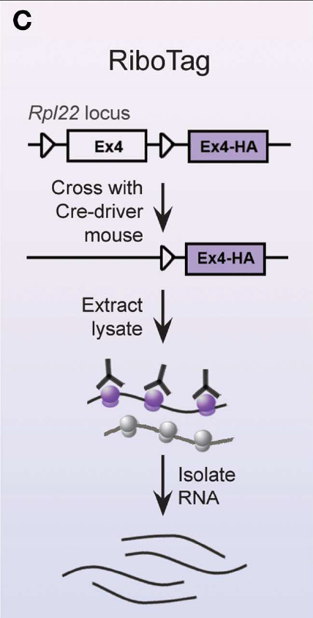
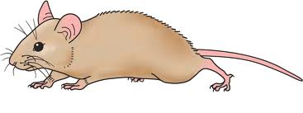

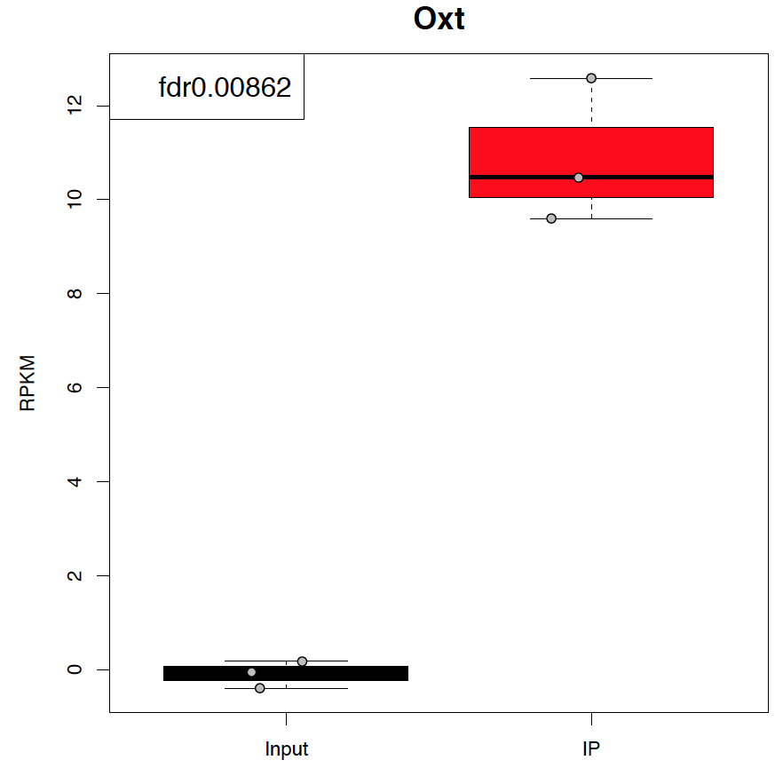
Ribo-seq to investigate how loss of BDNF from promoter I impacts gene expression in OXT neurons of Bdnf-e1 females
F1
Oxt^{Cre}
x
Ribotag
F2
x
Oxt^{Cre}; Ribotag
Bdnf-e1 -/-
RNA-sequencing of ribosome-associated transcripts in OXT neurons of WT vs. Bdnf-e1 mutants
Notes:
From a molecular perspective, we are also really interested to understand how loss of BDNF production from promoter I impacts downstream pathways in oxytocin neurons. To address this question, we are using a Ribotag/RNAsequencing approach. The RiboTag mouse expresses a HA tag on the ribosomal protein RPL22 (RPL22^{HA}) under control of Cre recombinase. After crossing the RiboTag mouse to a cell-type specific Cre driver, in our case oxytocin Cre, ribosomal-associated mRNAs from the targeted cell-type can be affinity purified with a HA antibody. Translating mRNAs are characterized using high-throughput methods, such as microarrays and RNA-seq. We have been setting up this technique in the lab using Oxt mice crossed to Ribotag mouse, and have some preliminary data showing that we are able to successfully purify ribosome-associated transcripts in Oxt neurons. Here you can see by qPCR that ribosome-associated transcripts in oxytocin neurons are enriched in oxytocin neurons compared to input (input being total hypothalamic homogenate). We are also able to sequence these low concentration samples and show enrichment of Oxt in OXT neurons. Now that we have the technique set up, we are doing the experiments to compare the molecular profiles of Oxt neurons in WT and Bdnf-e1 mutants.

Slide 2
A
B
I can also add in Agrp and Carpt for de-enriched genes. I’m not sure there is another obvious enriched gene for OXT, but we can think about this. AVP might be controversial since some people feel they are co-expressed and others not.
C
D
E

Slide 3
Alternative or other things to include
This is the same as E in previous slide, just presented differently.

